Slide 1
4-Bit Universal Shift Register
Cadence
Full-Custom IC Design
Harman Semicon. Arcademy 6th
김민지, 김도엽, 김민석, 고호철
서울기술교육센터

Slide 2
INDEX
01
02
03
Project Outline
Digital Logic Gate / Circuit
Asynchronous-reset TGFF
■ About Universal Shift Register
■ Reason for selecting
Universal Shift Register
■ Program & Tool
■ NOT
■ 2NAND
■ XOR
■ 2x1 MUX Switch
■ 4x1 MUX Switch
■ Transmission gate D-F/F
■ Transmission Gate D F/F (TGFF)
■ Asychronous-reset TGFF
■ Operation
■ Schematic & Symbol
■ Simulation (W/ Setup, Hold Time)
■ Layout & DRC & LVS
■ Appendix 1 : D F/F vs TGFF
04
05
Universal Shift Register
Review
■ Operation
■ Schematic &Symbol & Simulation
■ Layout & DRC & LVS
■ Appendix 2 : Max Freq. / Setup time
■ Review

Slide 3
01
Project Outline
About Universal Shift Register
Reason for selecting Universal Shift Register
Program & Tool

Slide 4
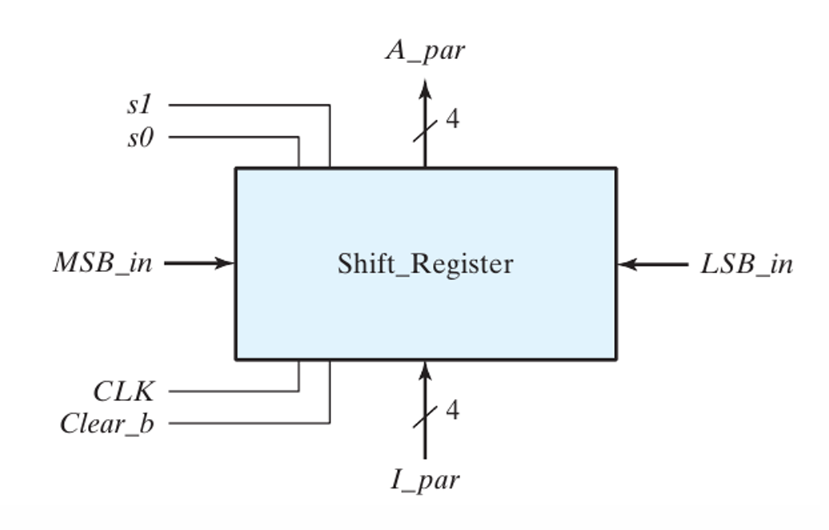
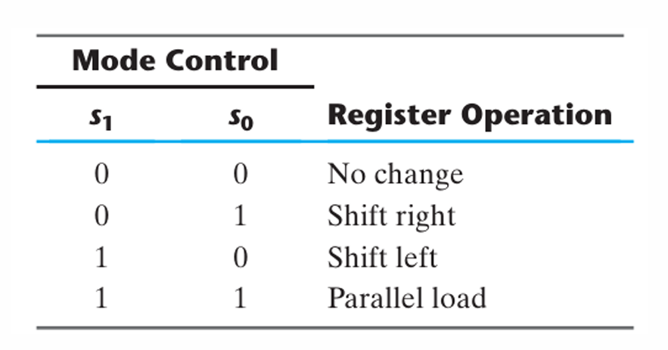
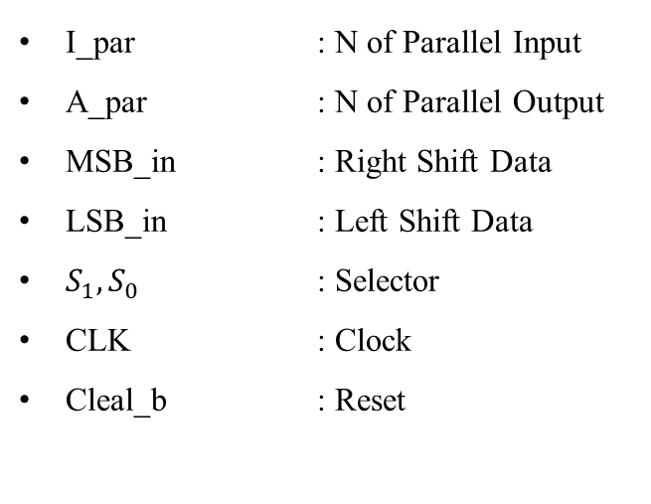
01 : Project Outline
About Universal Shift Register
< Function >
Shift Register
1-1. Left Shift Register
1-2. Right Shift Register
2. Data holding
3. Parallel loading
I_par : N of Parallel Input
A_par : N of Parallel Output
MSB_in : Right Shift Data
LSB_in : Left Shift Data
$S_{1}, S_{0}$ : Selector
CLK : Clock
Cleal_b : Reset
Universal Shift Register
<Universal Shift Register Truth Table>
Universal Shift Register Truth Table

Slide 5
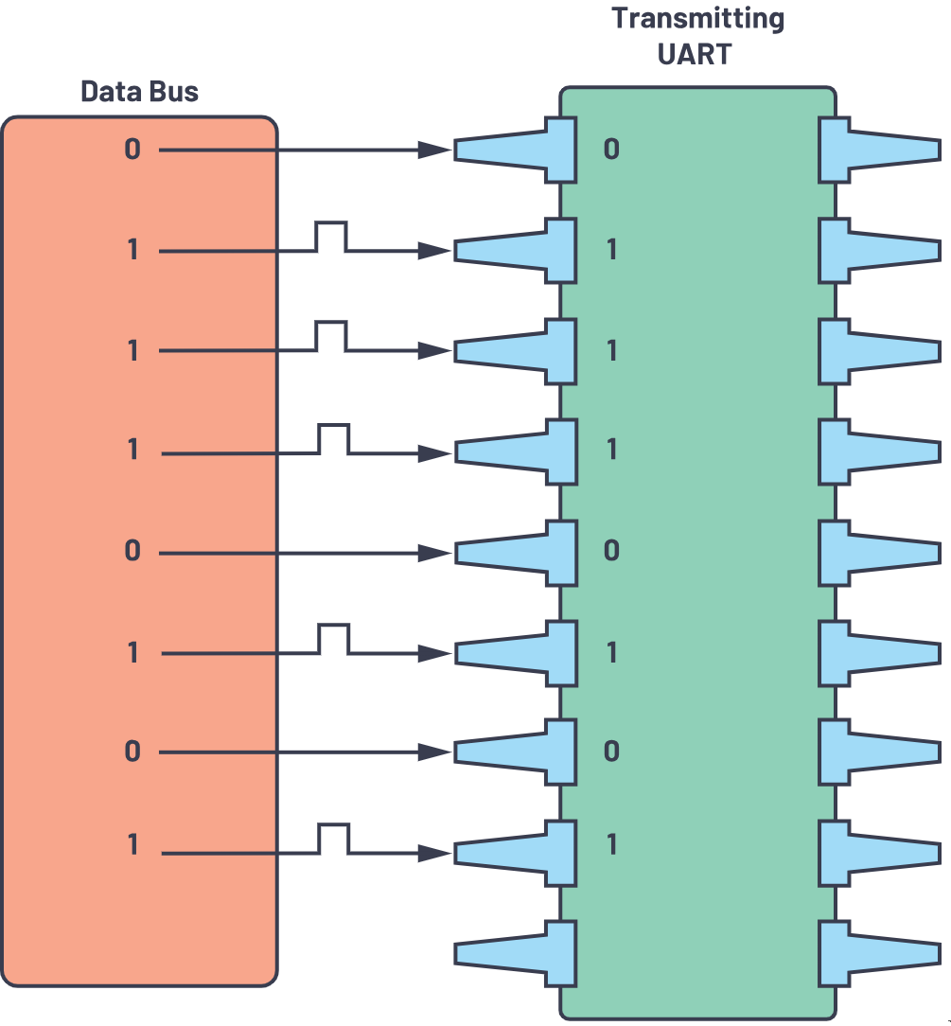
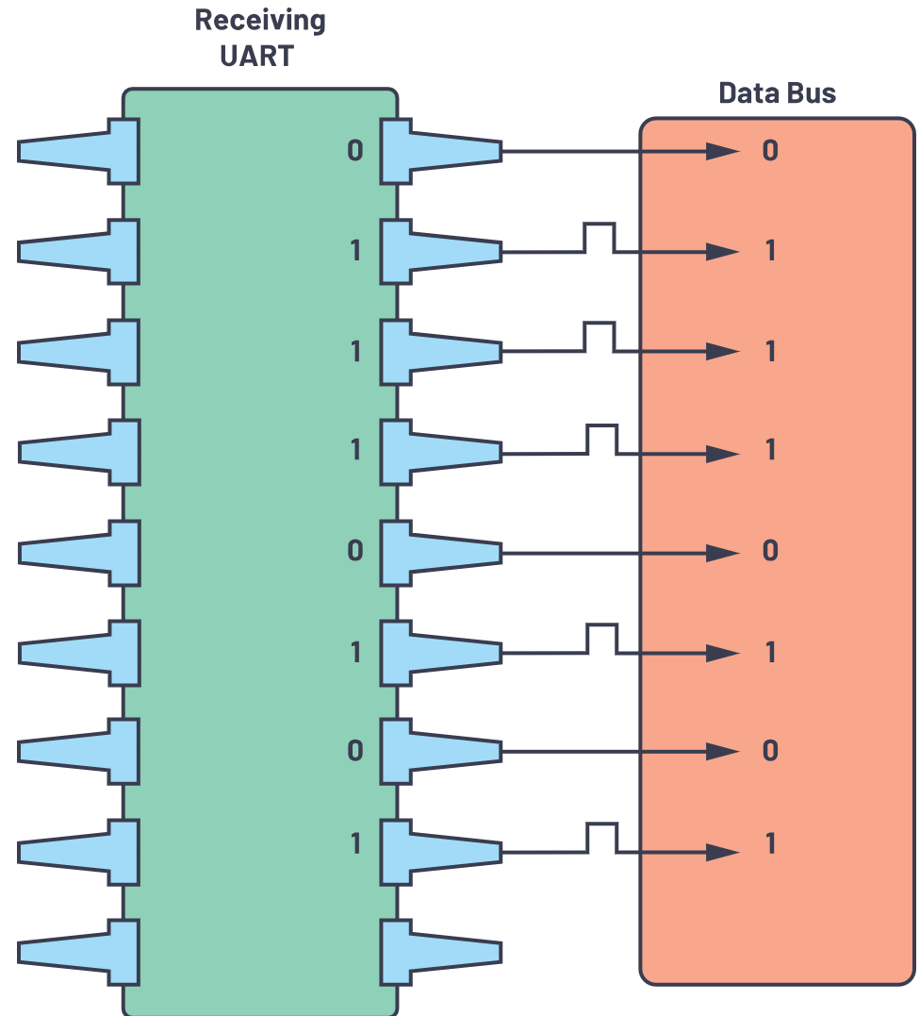
01 : Project Outline
Reason for selecting Universal Shift Register
UART(Universal Asynchronous Receiver/Transmitter) - 1
Data : Parallel to Serial
Data : Serial to Parallel
Parallel load
Transmit
Parallel load
Shift
Shift
Transmitter
Receiver

Slide 6
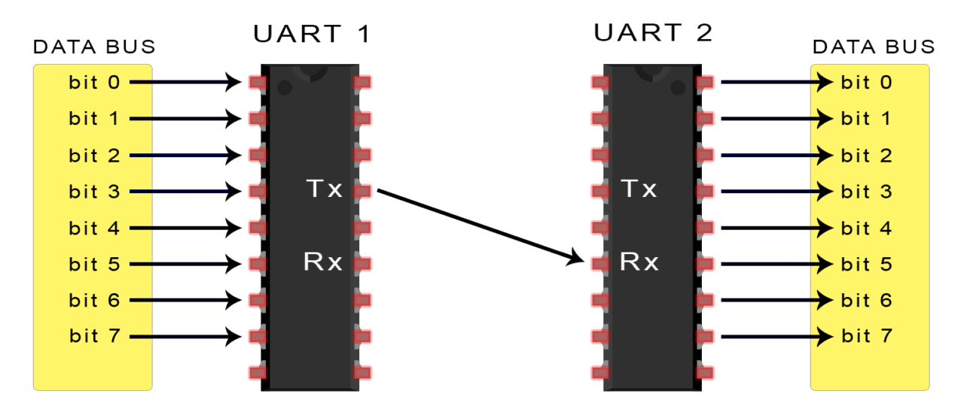
01 : Project Outline
Reason for selecting Universal Shift Register
UART(Universal Asynchronous Receiver/Transmitter) - 2
Standard Device for Serial Communication
Transmitter
Convert Parallel data to Serial data
Parallel data is loaded into the Shift Register
→ Data is serialized
→ Transmitted through the Serial port
Receiver
Convert Serial data to Parallel data
Serial data is shifted bit by bit
→ convert it into parallel data
→ each bit is shifted and stored in a parallel register
<UART>
UART
< Receiver Process >
Serial data receive
Bit receive
Store data in Shift Register
Frame Detection
Convert to Parallel data

Slide 7


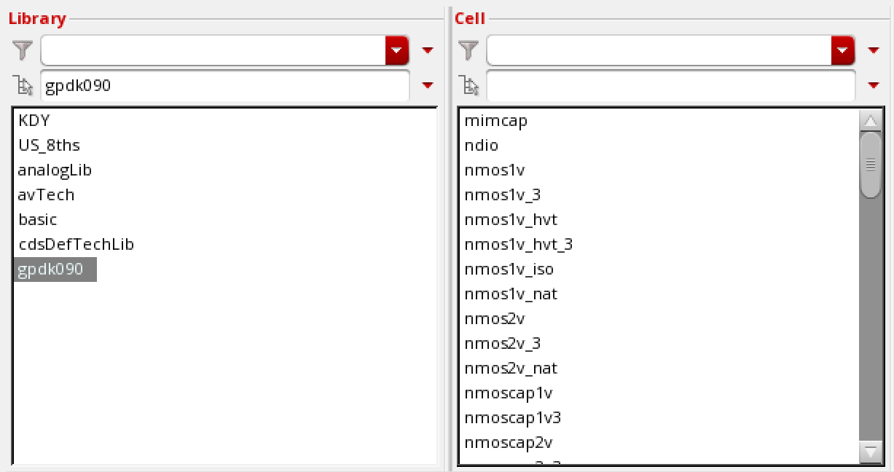
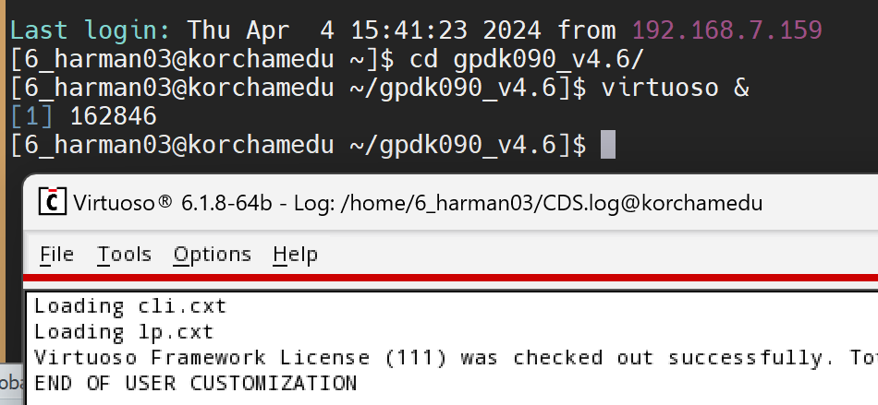
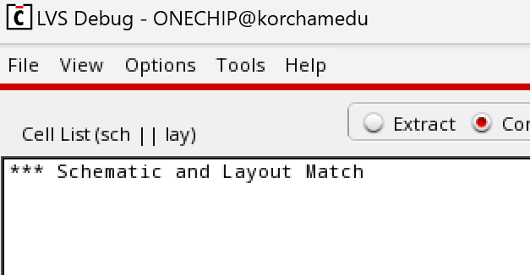
01 : Project Outline
Program & Tool
01
02
03
Cadence Virtuoso
Assura
Library
■ Schematic Editor
■ Layout Editor
■ Specture / ADE
■ DRC
■ LVS
■ gpdk_090

Slide 8
02
Design Logic Gate
NOT Gate
2NAND Gate
XOR Gate
2x1 MUX SWITCH
4x1 MUX SWITCH
Transmission Gate D-F/F

Slide 9
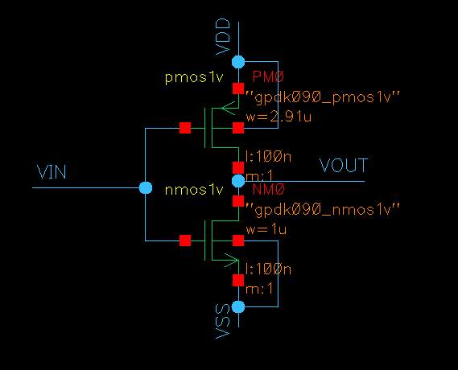
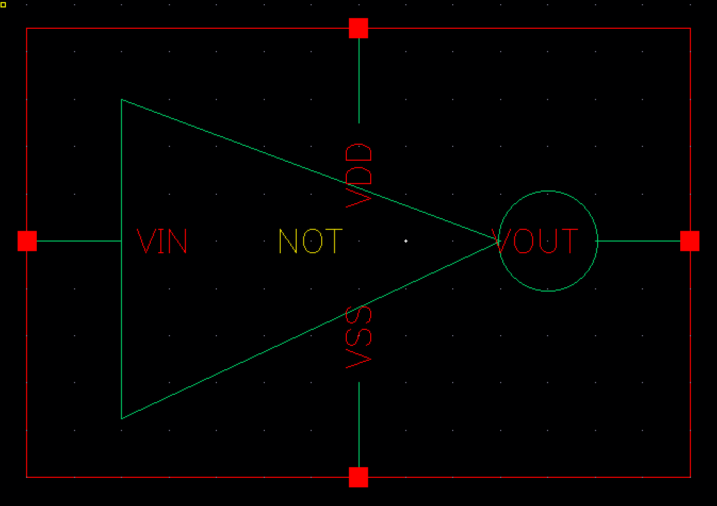
02 : Digital Logic Gate
NOT Gate
Schematic
Symbol

Slide 10
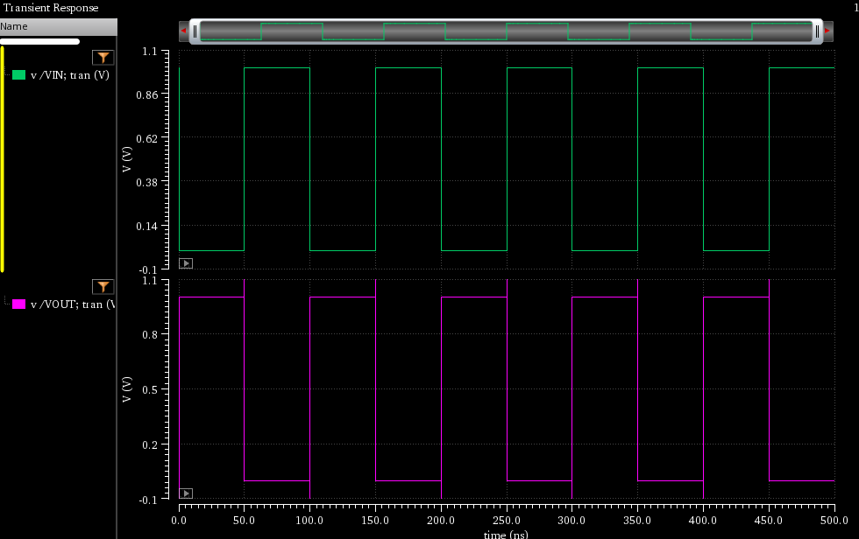
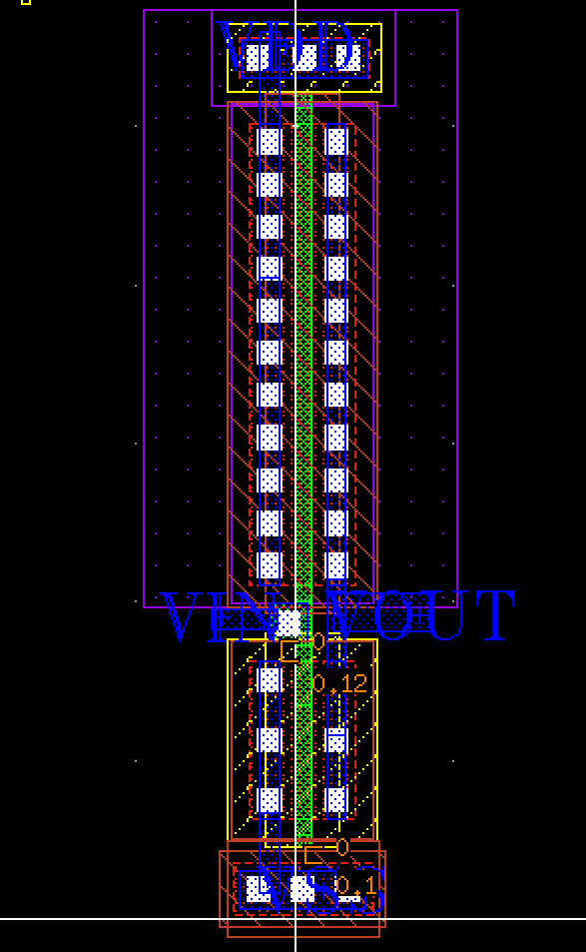
02 : Digital Logic Gate
NOT Gate
Simulation
Layout
VIN
0 1 0 1 0 1 0 1 0 1
VOUT
1 0 1 0 1 0 1 0 1 0
Length | 2.56
Width | 7.095
Vin | Vout
0 | 1
1 | 0
Scale : [um]

Slide 11
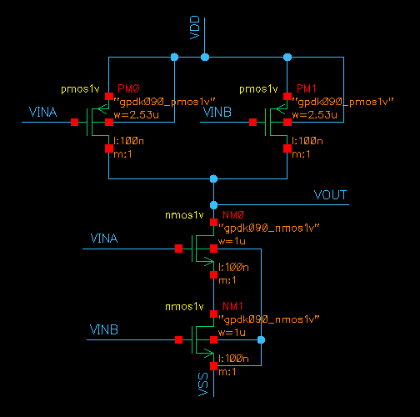
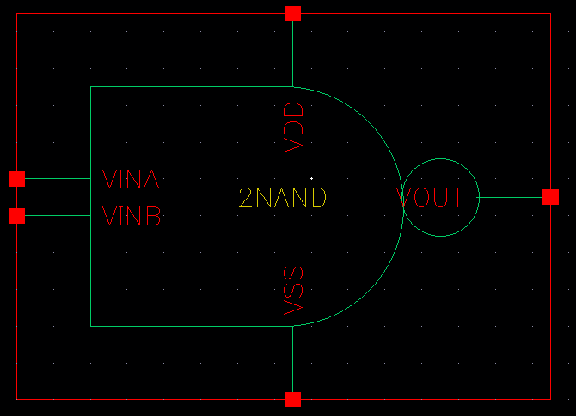
02 : Digital Logic Gate
2NAND Gate
Schematic
Symbol

Slide 12
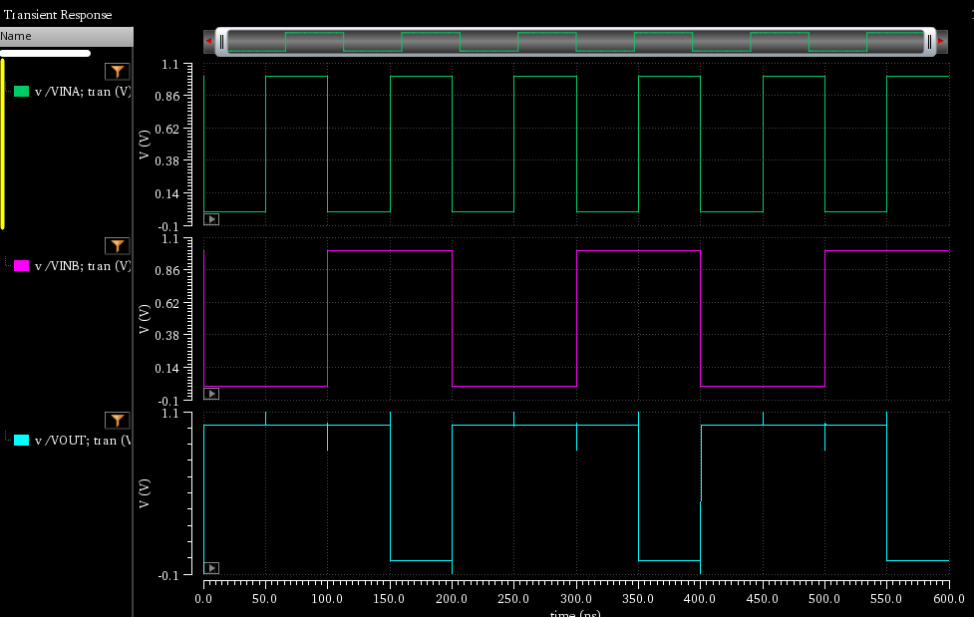
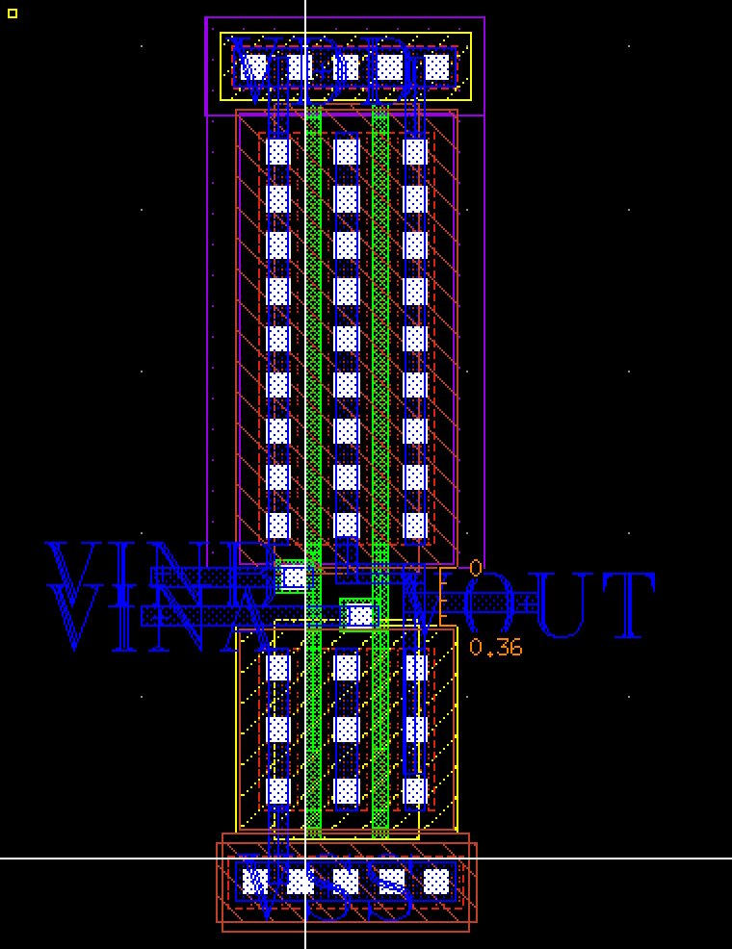
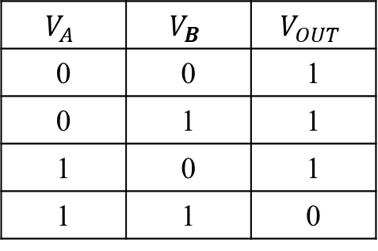
02 : Digital Logic Gate
2NAND Gate
Simulation
Layout
VINA
0 1 0 1 0 1 0 1 0 1 0 1
VINB
0 0 1 1 0 0 1 1 0 0 1 1
VOUT
1 1 1 0 1 1 1 0 1 1 1 0
$$V_{A}$$ | $$V_{B}$$ | $$V_{OUT}$$
0 | 0 | 1
0 | 1 | 1
1 | 0 | 1
1 | 1 | 0
Length | 1.715
Width | 5.62
Scale : [um]

Slide 13
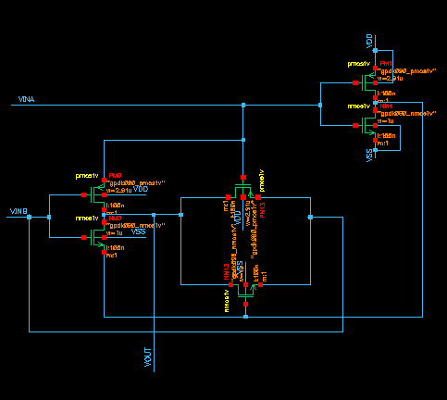
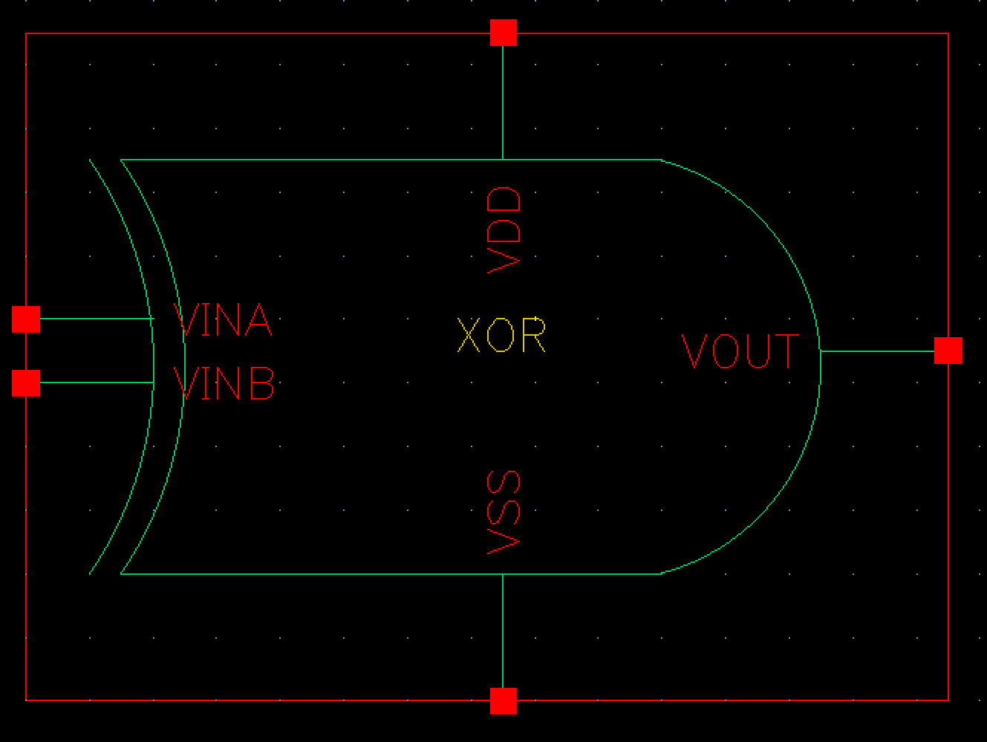
02 : Digital Logic Gate
XOR Gate
Schematic
Symbol

Slide 14
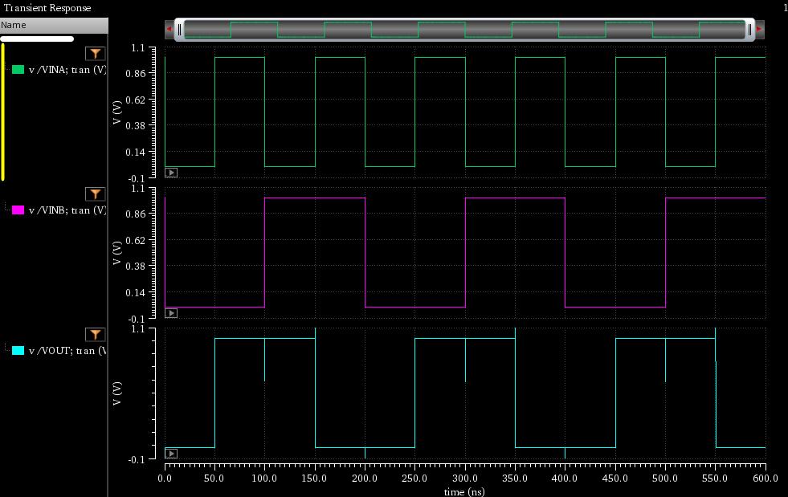
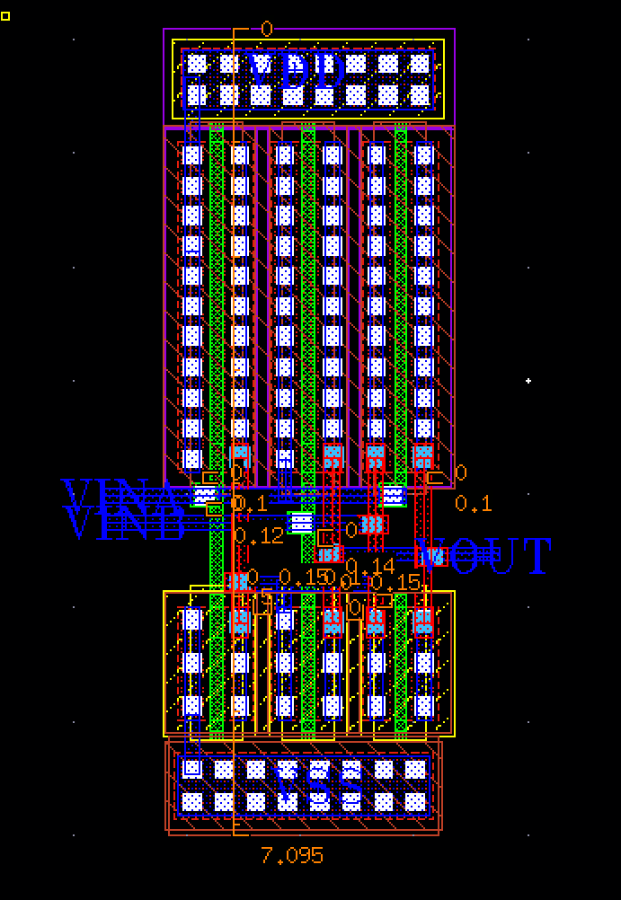
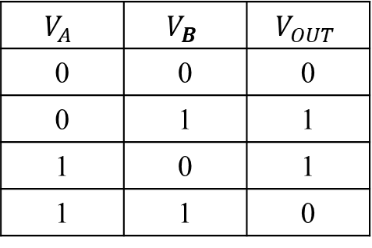
02 : Digital Logic Gate
XOR Gate
Simulation
Layout
VINA
0 1 0 1 0 1 0 1 0 1 0 1
VINB
0 0 1 1 0 0 1 1 0 0 1 1
VOUT
0 1 1 0 0 1 1 0 0 1 1 0
$$V_{A}$$ | $$V_{B}$$ | $$V_{OUT}$$
0 | 0 | 0
0 | 1 | 1
1 | 0 | 1
1 | 1 | 0
Length | 2.905
Width | 7.095
Scale : [um]

Slide 15
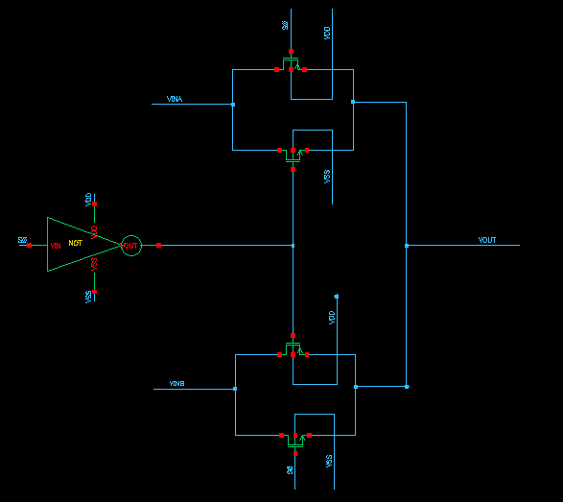
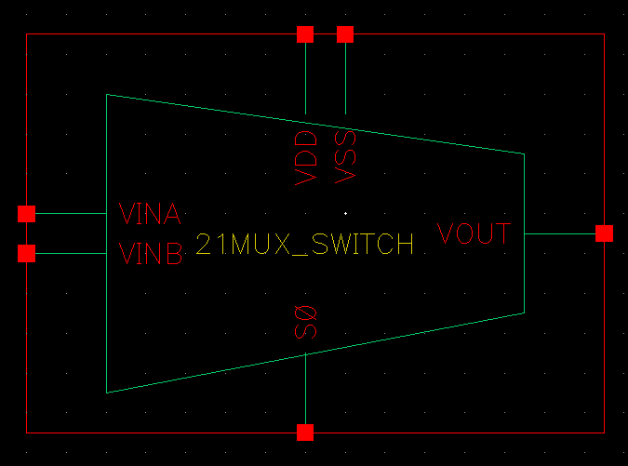
02 : Digital Logic Gate
2x1 MUX SWITCH
Schematic
Symbol

Slide 16
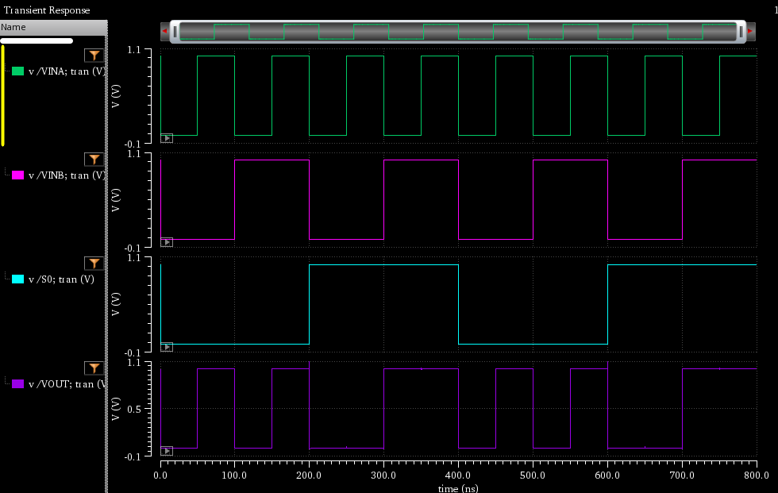
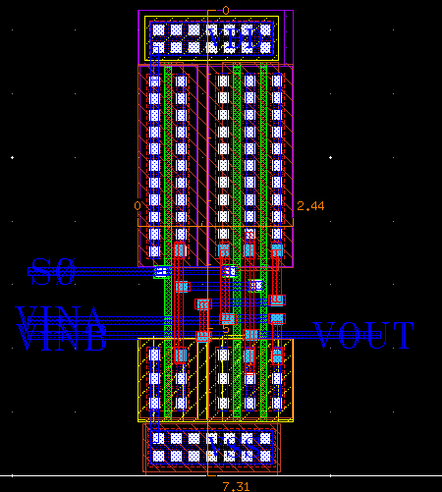
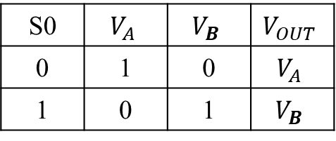
02 : Digital Logic Gate
2x1 MUX SWITCH
Simulation
Layout
VINA
A
0 1 0 1 0 1 0 1 0 1 0 1
VINB
B
S0
0 1
0 1 1 0 0 1 1 0 0 1 1 0
VOUT
A B
Length | 2.44
Width | 7.31
S0 | $$V_{A}$$ | $$V_{B}$$ | $$V_{OUT}$$
0 | 1 | 0 | $$V_{A}$$
1 | 0 | 1 | $$V_{B}$$
Scale : [um]

Slide 17
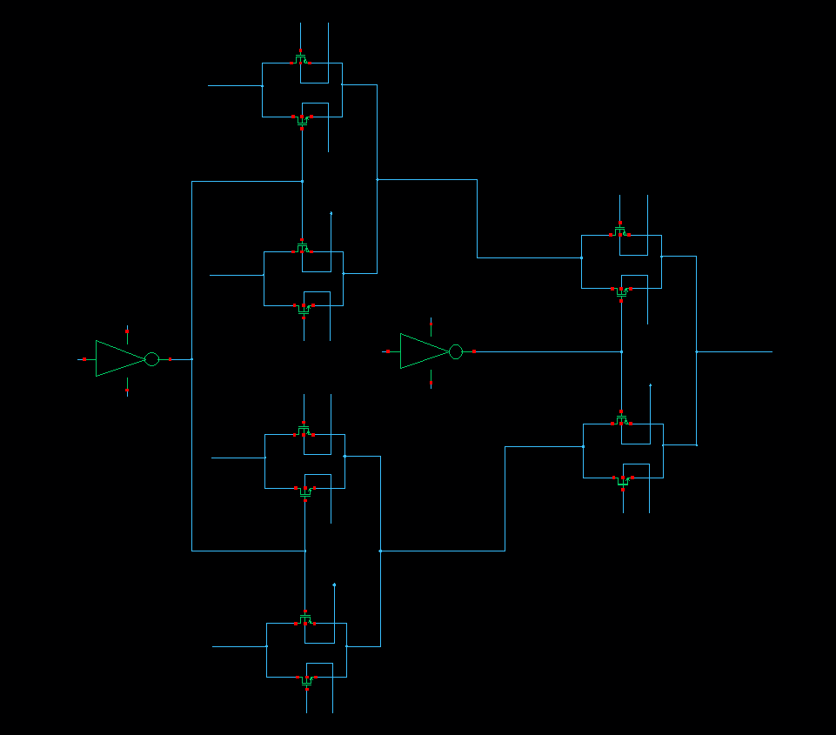
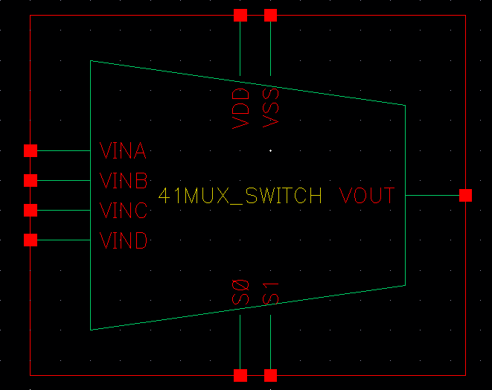
02 : Digital Logic Gate
4x1 MUX SWITCH
Schematic
Symbol

Slide 18
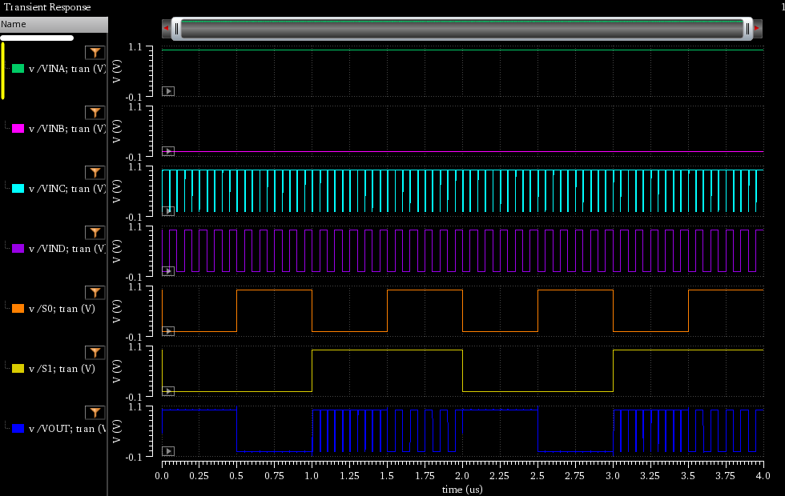
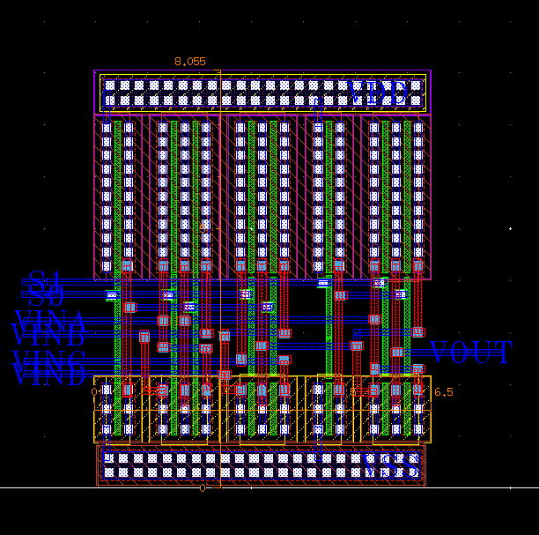
02 : Digital Logic Gate
4x1 MUX SWITCH
Simulation
Layout
VINA
A
VINA
0 1 0 1 0 1 0 1 0 1 0 1 0 1 0 1
0 1 0 1 0 1 0 1 0 1 0 1
B
VINB
VINB
C
VINC
0 0 1 1 0 0 1 1 1 1 0 0 0 0 1 1
D
VIND
S0
0 0 0 0 1 1 1 1 0 0 0 0 1 1 1 1
0 1 0 1
S0
0 1 1 0 0 1 1 0 0 1 1 0
0 0 1 1
S1
0 1 0 1 0 0 1 1 0 1 0 1 0 0 1 1
VOUT
A B C D
Length | 6.5
Width | 8.055
VOUT
Scale : [um]

Slide 19
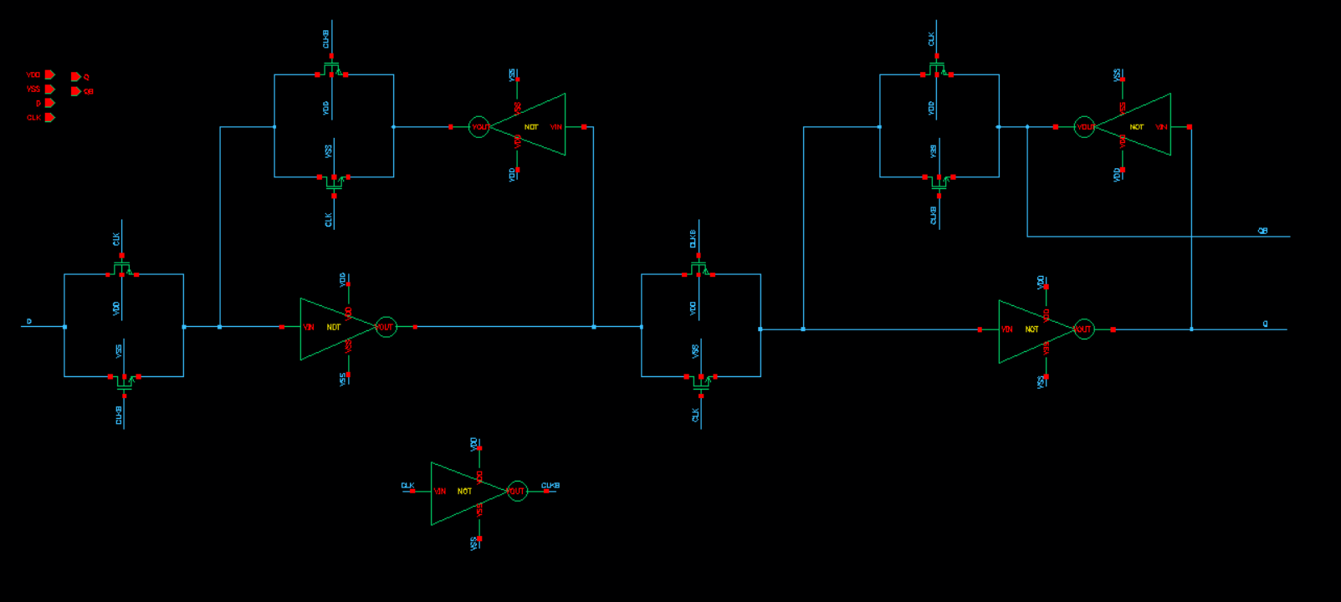
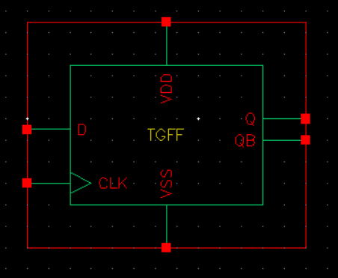
02 : Digital Logic Gate
Transmission Gate D-F/F
Schematic
Symbol

Slide 20
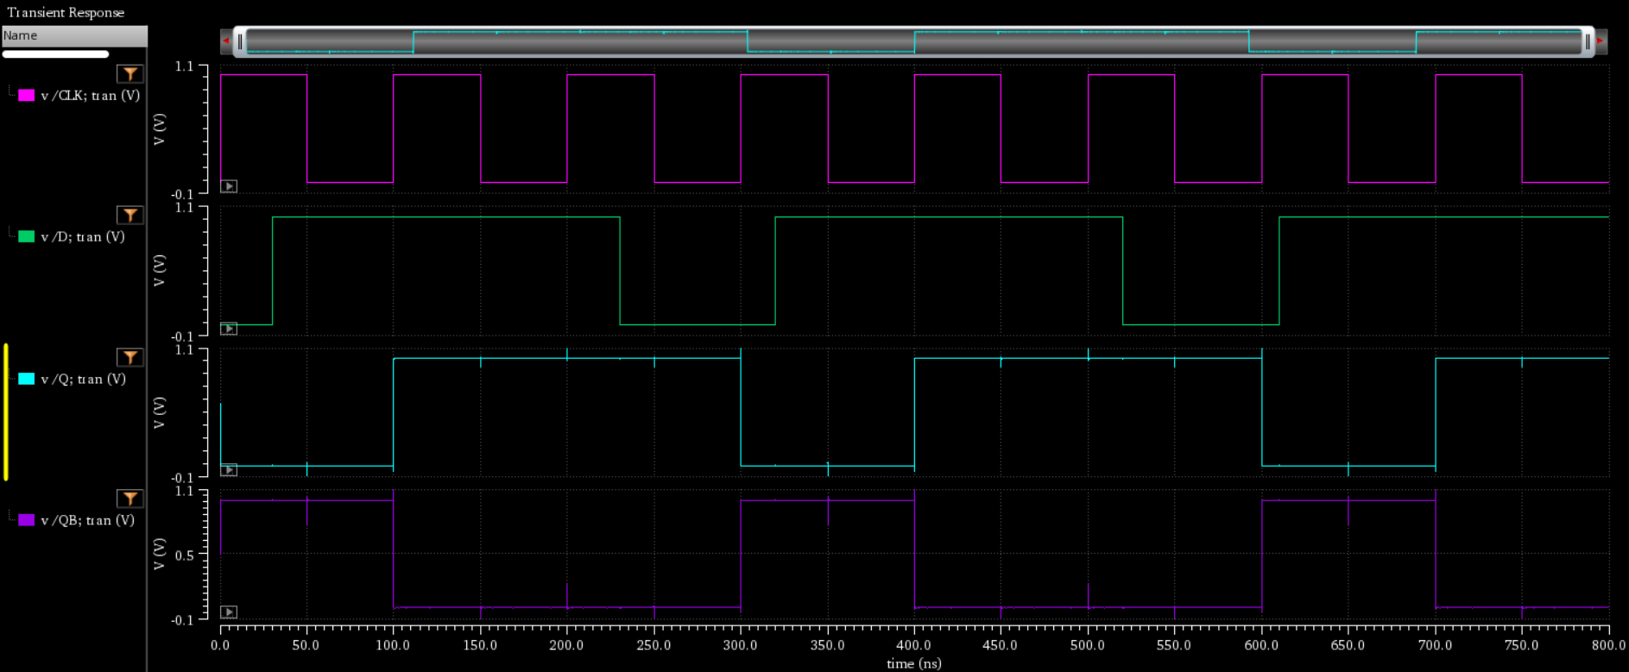
02 : Digital Logic Gate
Transmission Gate D-F/F
Simulation
CLK
Input(D)
Output (Q)
Q’

Slide 21
TGFF : Transmission Gate D-F/F
Asynchronous-reset TGFF
Operation
Schematic & Symbol
Simulation
Layout (W/ DRC & LVS)
Appendix : D F/F vs Asynch.-reset TGFF
03
Asynchronous-reset TGFF

Slide 22
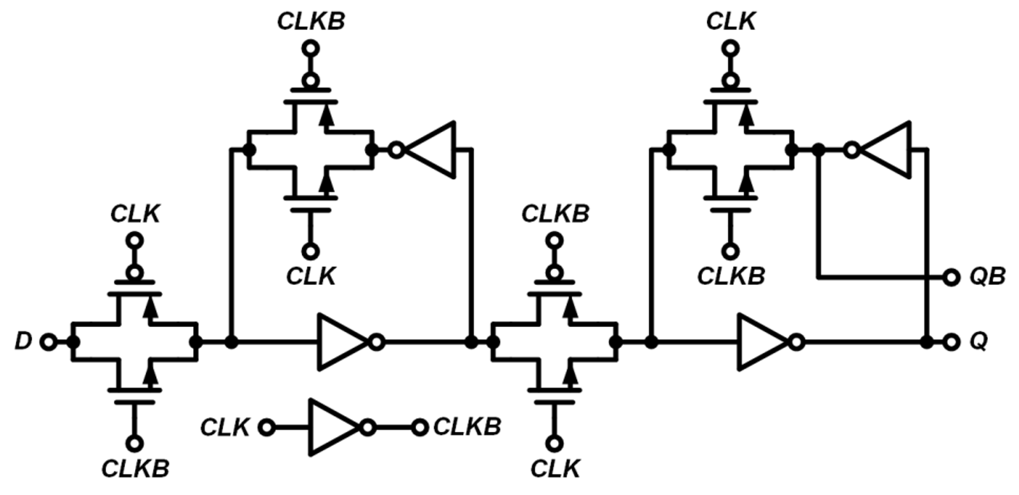
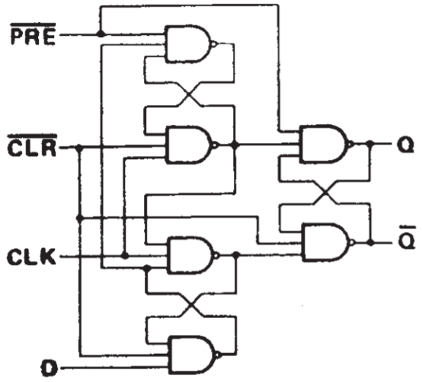
03 : Asynchronous-reset TGFF
TGFF : Transmission Gate D-F/F
TGFF
Transmission Gate D-F/F
D-F/F With Transmission Gate
Representative Advantage
Area ( # of Transistors)
TGFF: 16 Transistors
Tr. of Transmission gate : 2 x 4 = 8
Tr. of Inverter : 2 x 4 = 8
D-F/F : 36 Transistors
Tr of 3NAND : 6 x 6 = 36
D-Flip/Flop

Slide 23
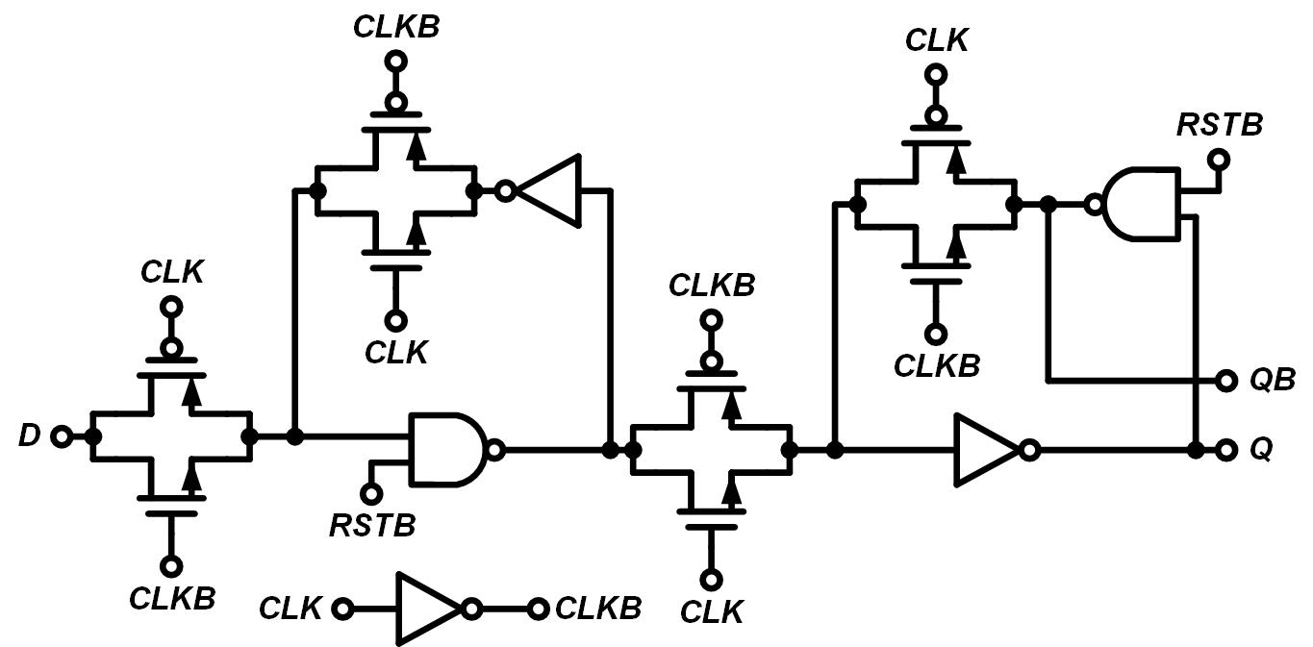
03 : Asynchronous-reset TGFF
Asynchronous-reset TGFF
Asynchronous-reset Transmission Gate D-F/F
Addition of Reset function
Asynchronous-reset TGFF
Why add a Reset function?
1. Improve system stability
System error occurred → Fast return to initial state
2. Reduce power consumption
an error or unnecessary operating state → quickly reset to its initial state to avoid unnecessary power consumption.

Slide 24
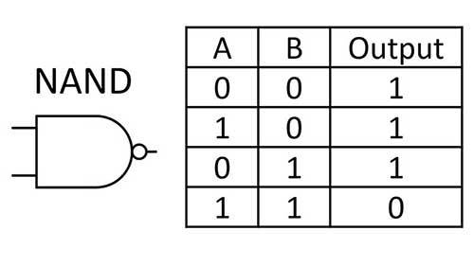
03 : Asynchronous-reset TGFF
Operation
CLK : Low
CLK : High (After positive edge)
(A)
<Asynchronous-reset TGFF>
<Asynchronous-reset TGFF>
Asynchronous-reset TGFF
Asynchronous-reset TGFF
If … RST = 1 (same as RSTB = 0)
Node (A) 2NAND Output = 1 → Q = 0
[cf.]
If one of the 2NAND inputs contains ‘0’, ‘1’ is unconditionally output.
2 NAND Truth table

Slide 25
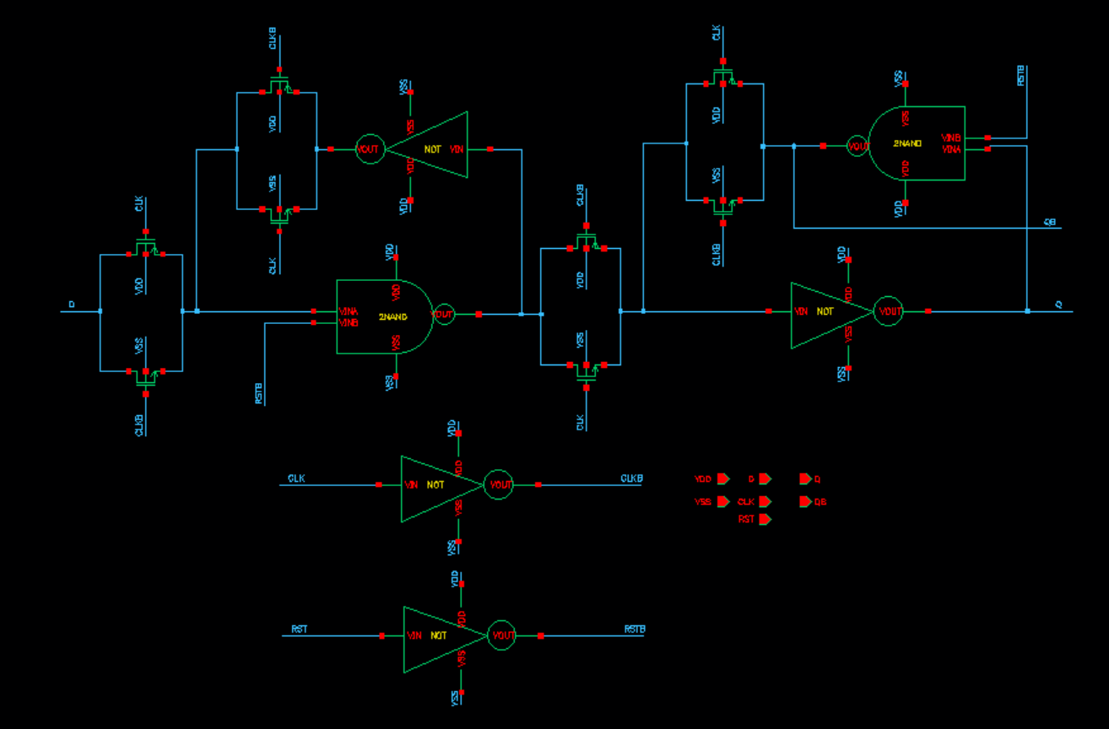
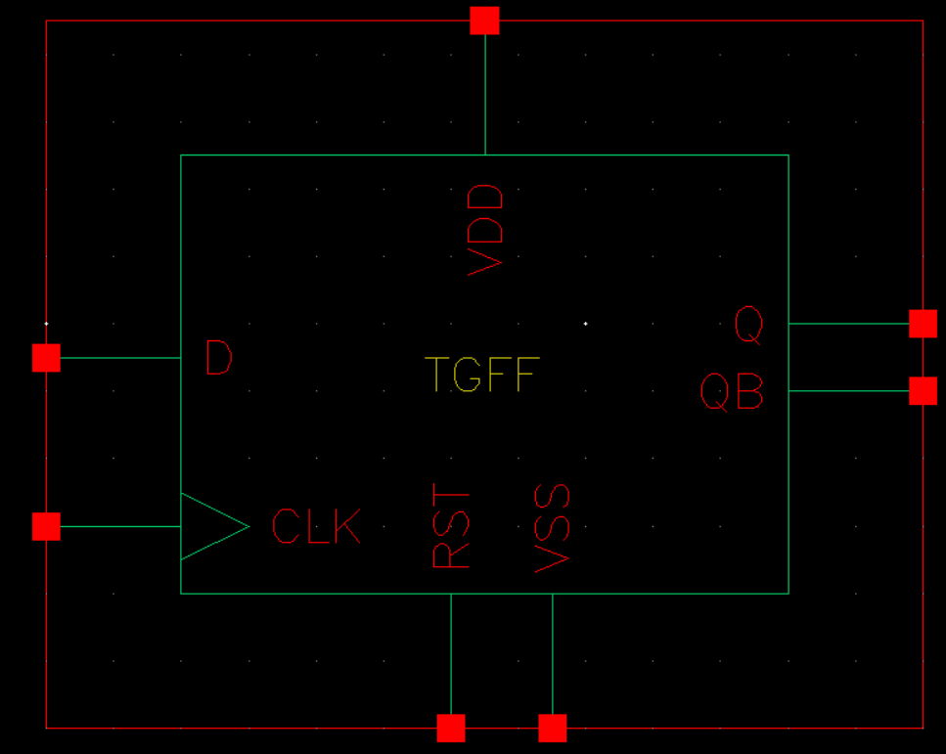
03 : Asynchronous-reset TGFF
Schematic & Symbol
Schematic
Symbol
RST’
2NAND
Q’
2NAND
Q
RST’

Slide 26
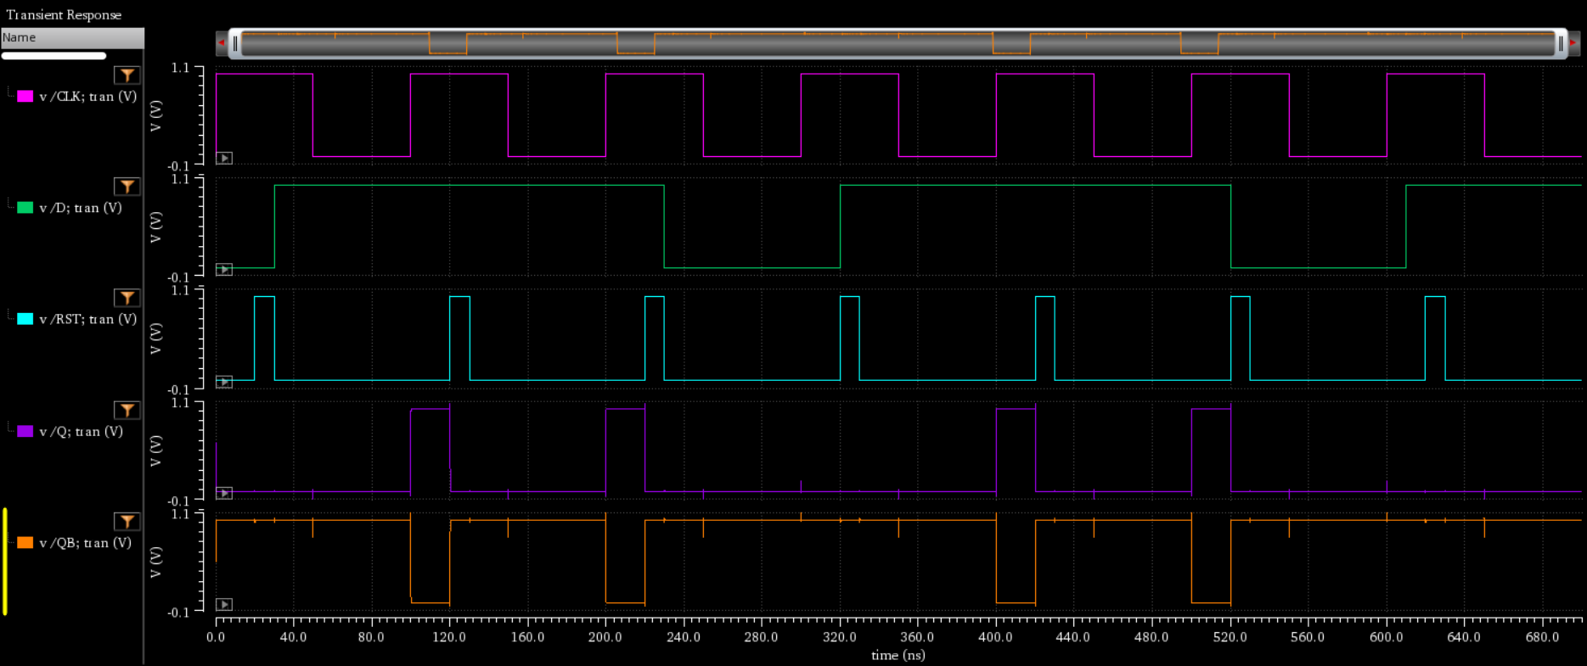
03 : Asynchronous-reset TGFF
Simulation
Simulation
CLK
Input(D)
RST
Output (Q)
Q’

Slide 27
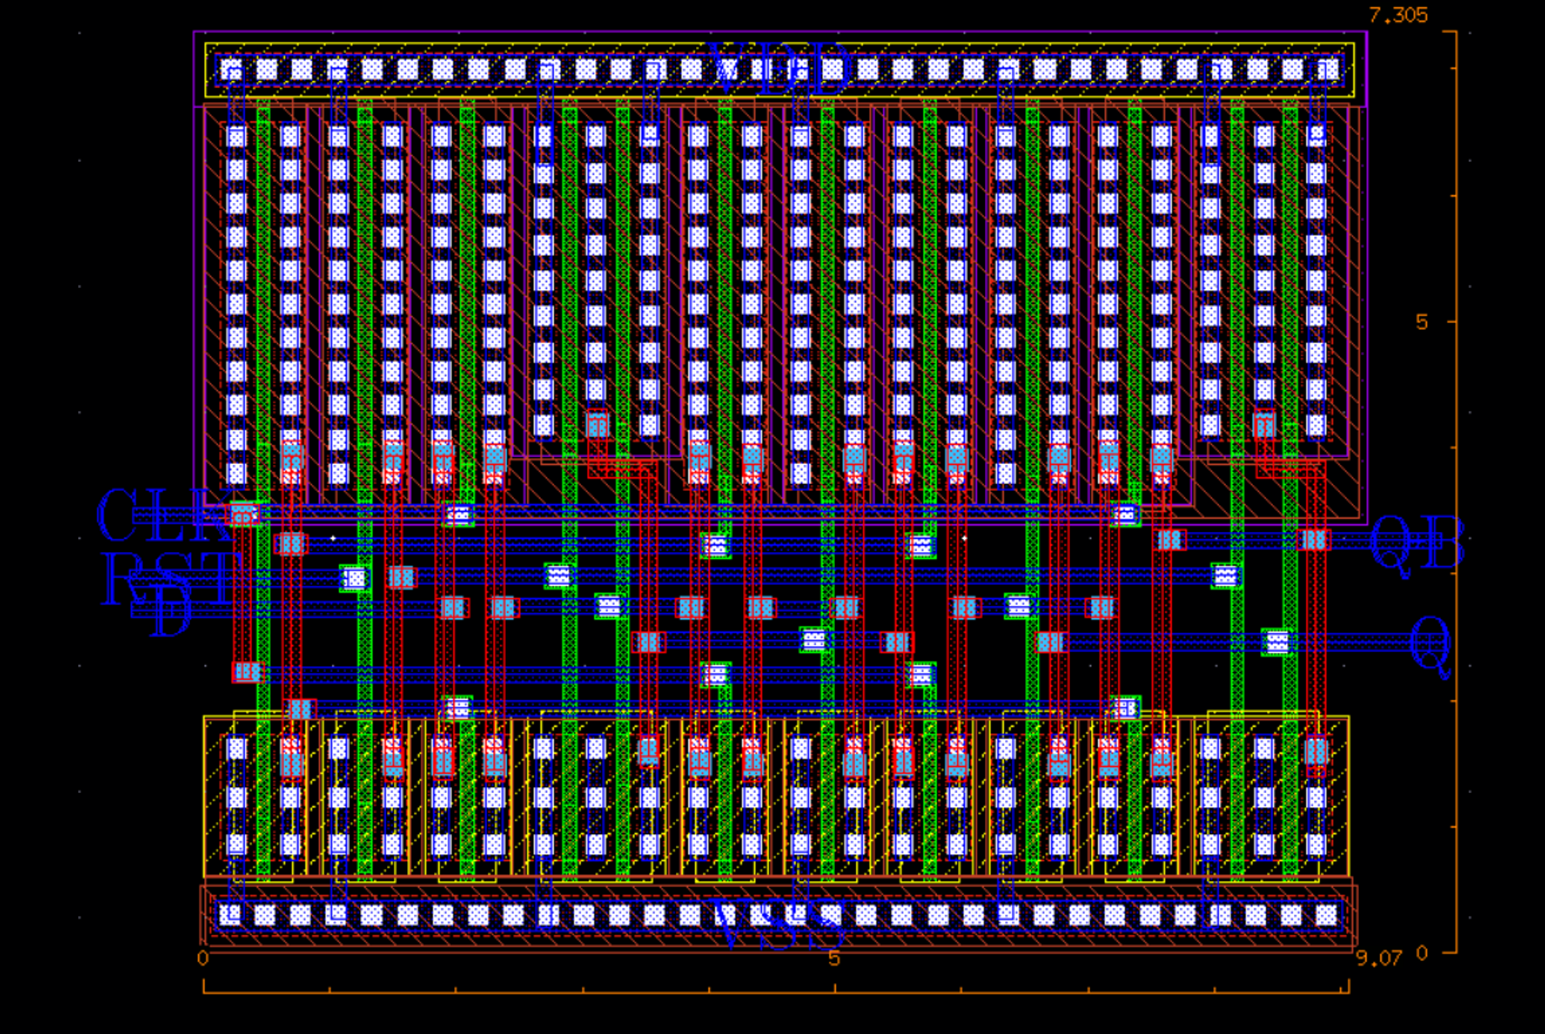
03 : Asynchronous-reset TGFF
Layout
Layout
Length | 7.305
Width | 9.07
Scale : [um]

Slide 28
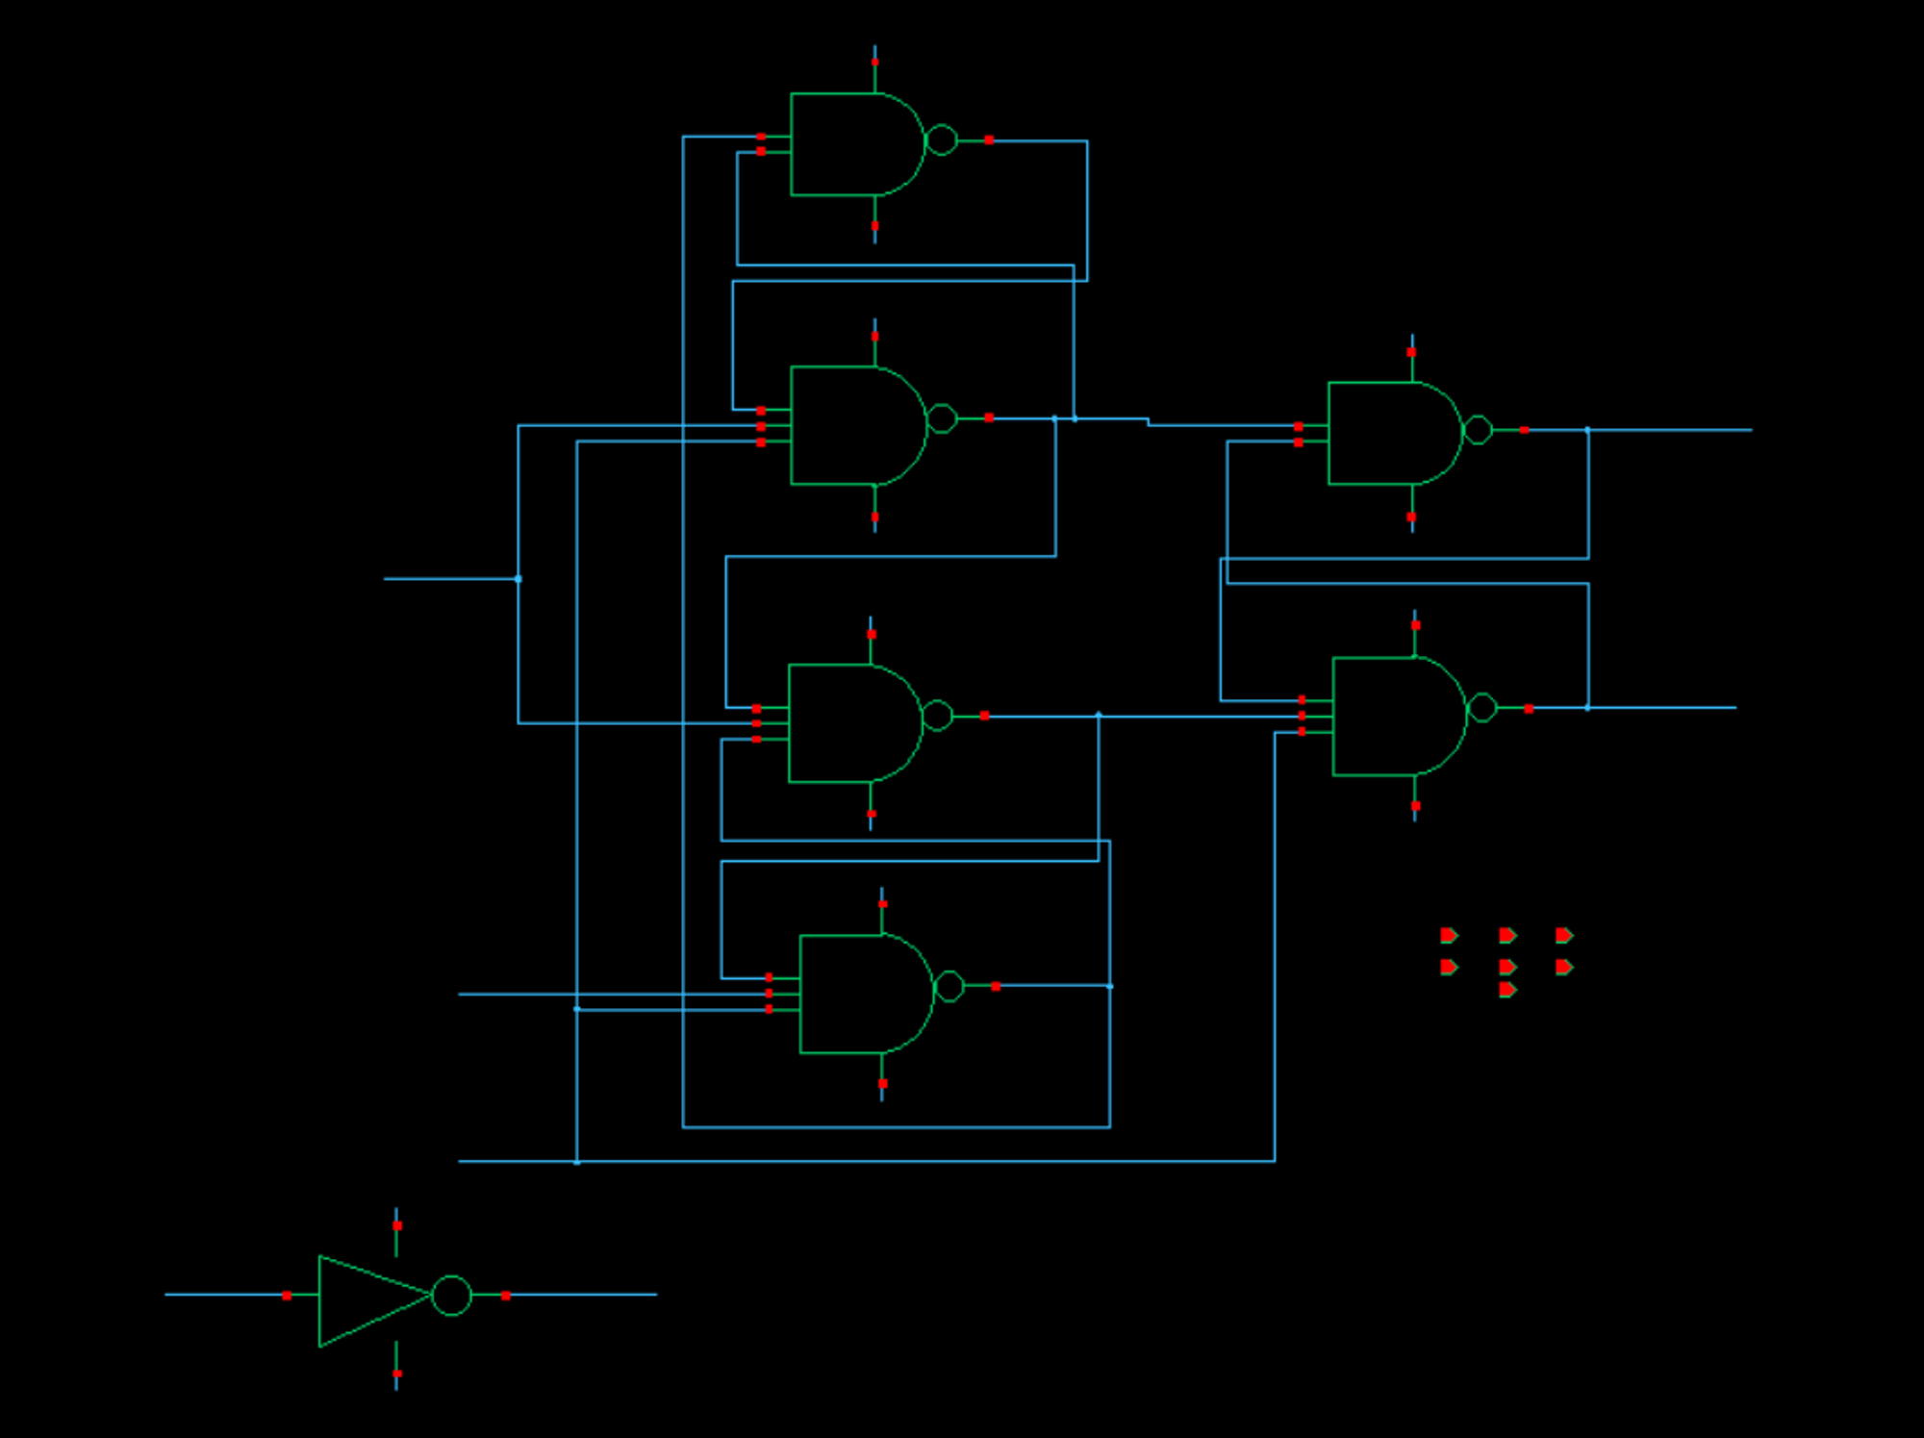
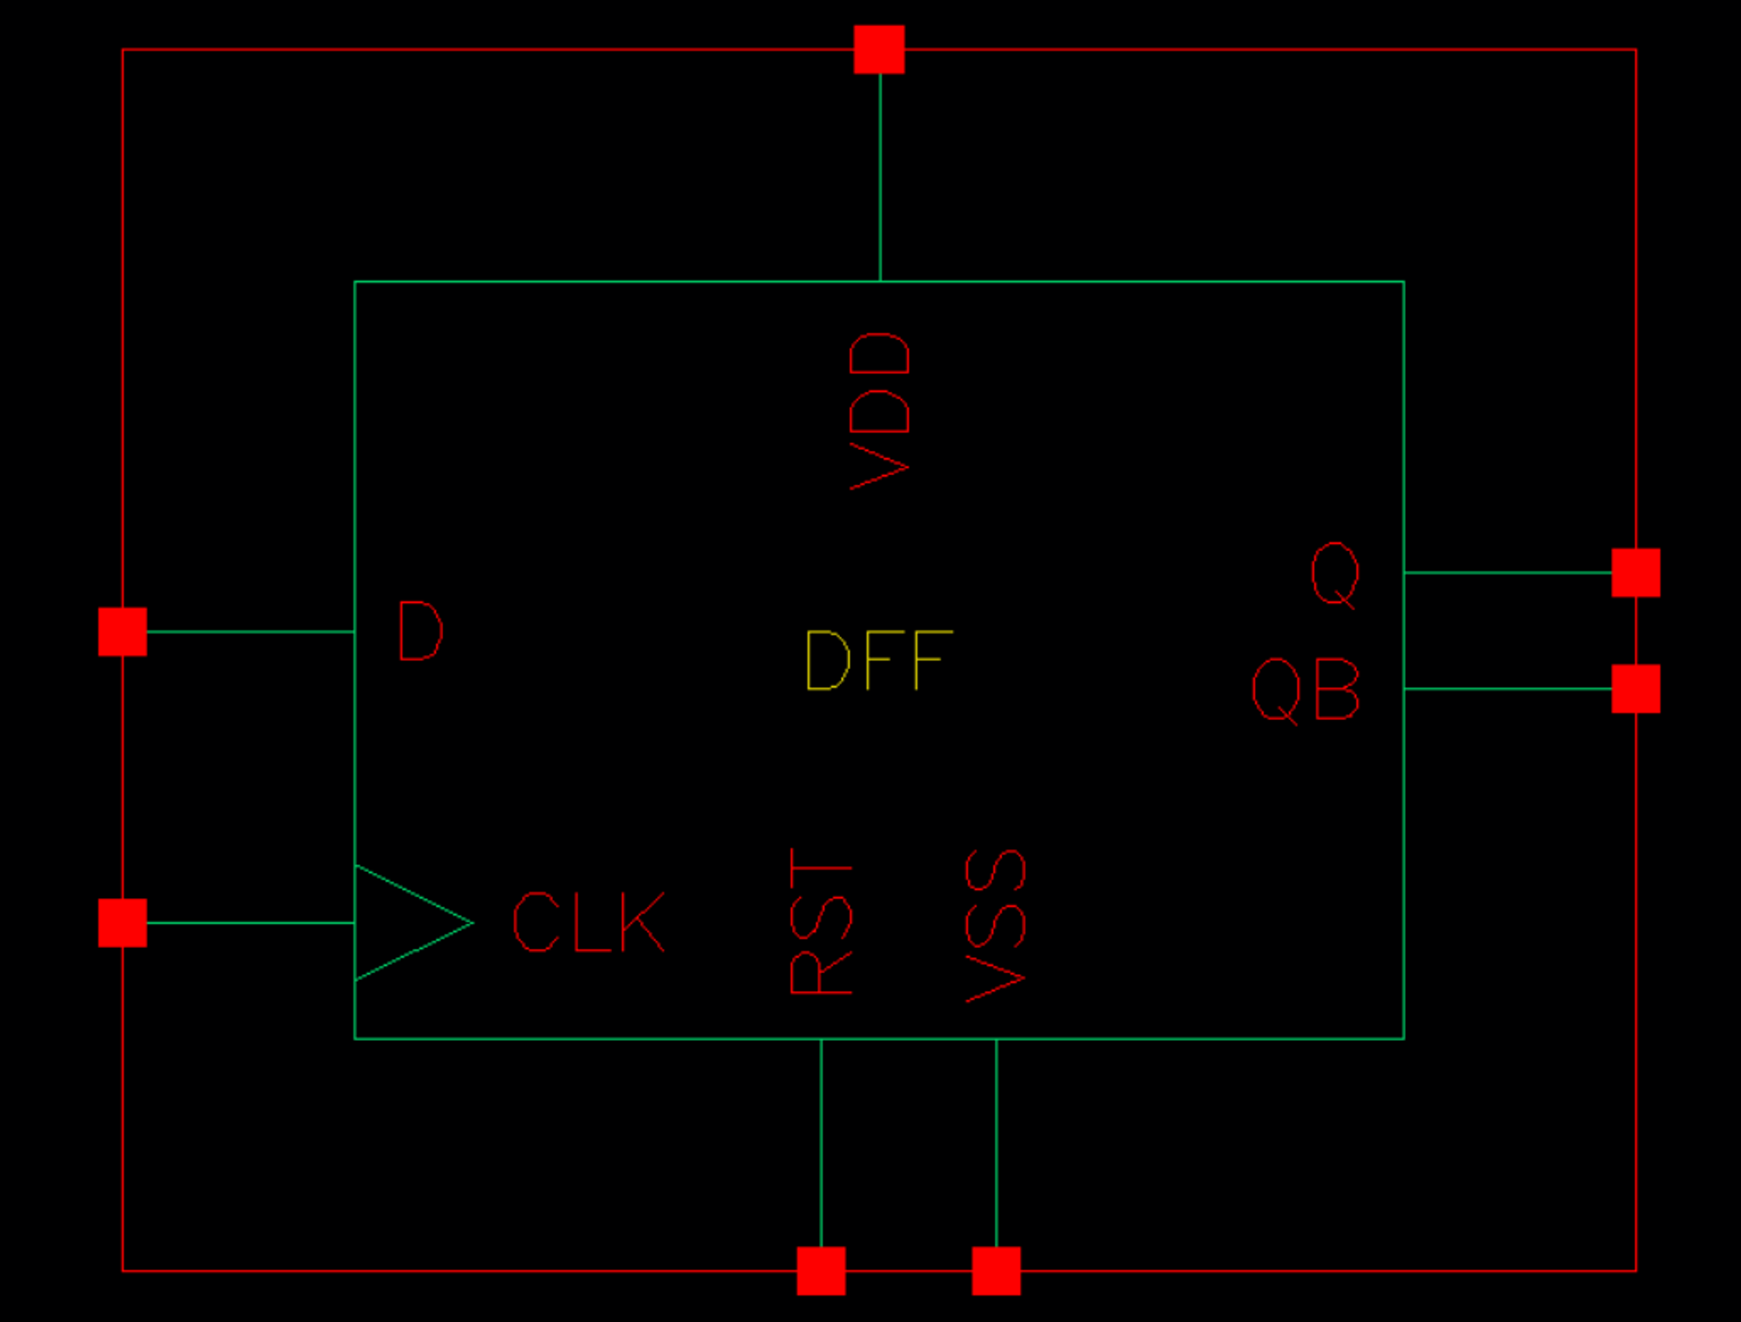
03 : Asynchronous-reset TGFF
Appendix : D F/F vs Asynch.-reset TGFF
D F/F Schematic
D F/F Symbol

Slide 29
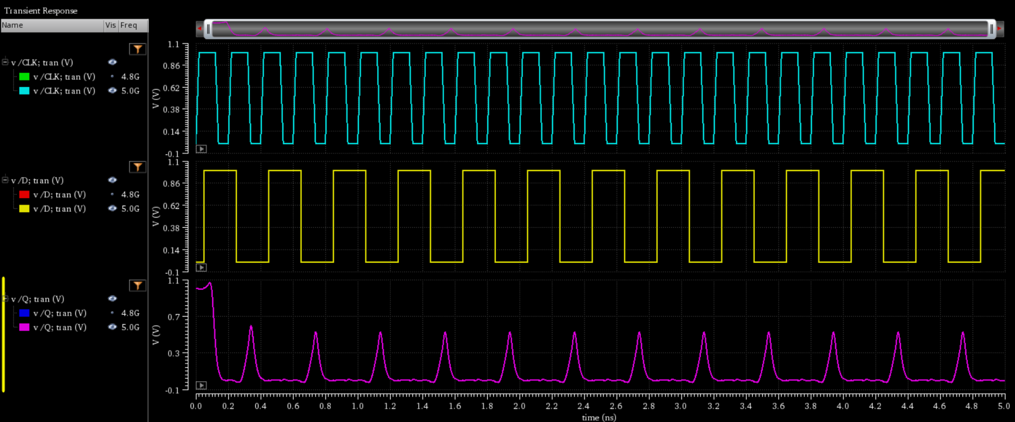
03 : Asynchronous-reset TGFF
Appendix : D F/F vs Asynch.-reset TGFF
D F/F Simulation at 5GHz
Output at 5GHz : Error data occurred

Slide 30
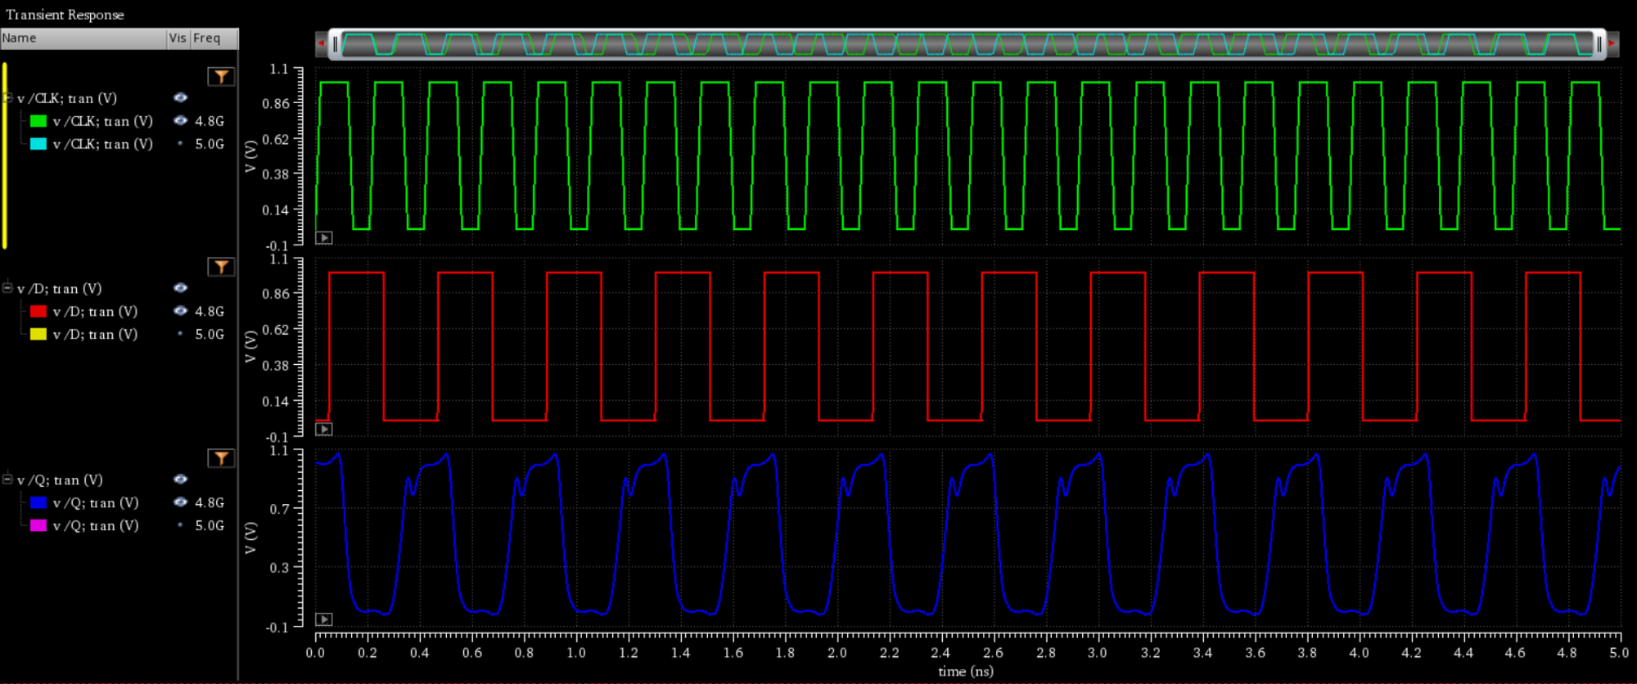
03 : Asynchronous-reset TGFF
Appendix : D F/F vs Asynch.-reset TGFF
D F/F Max-Frequency Simulation at 4.8 GHz
Output at 4.8GHz
Max. Frequency = 4.8GHz

Slide 31
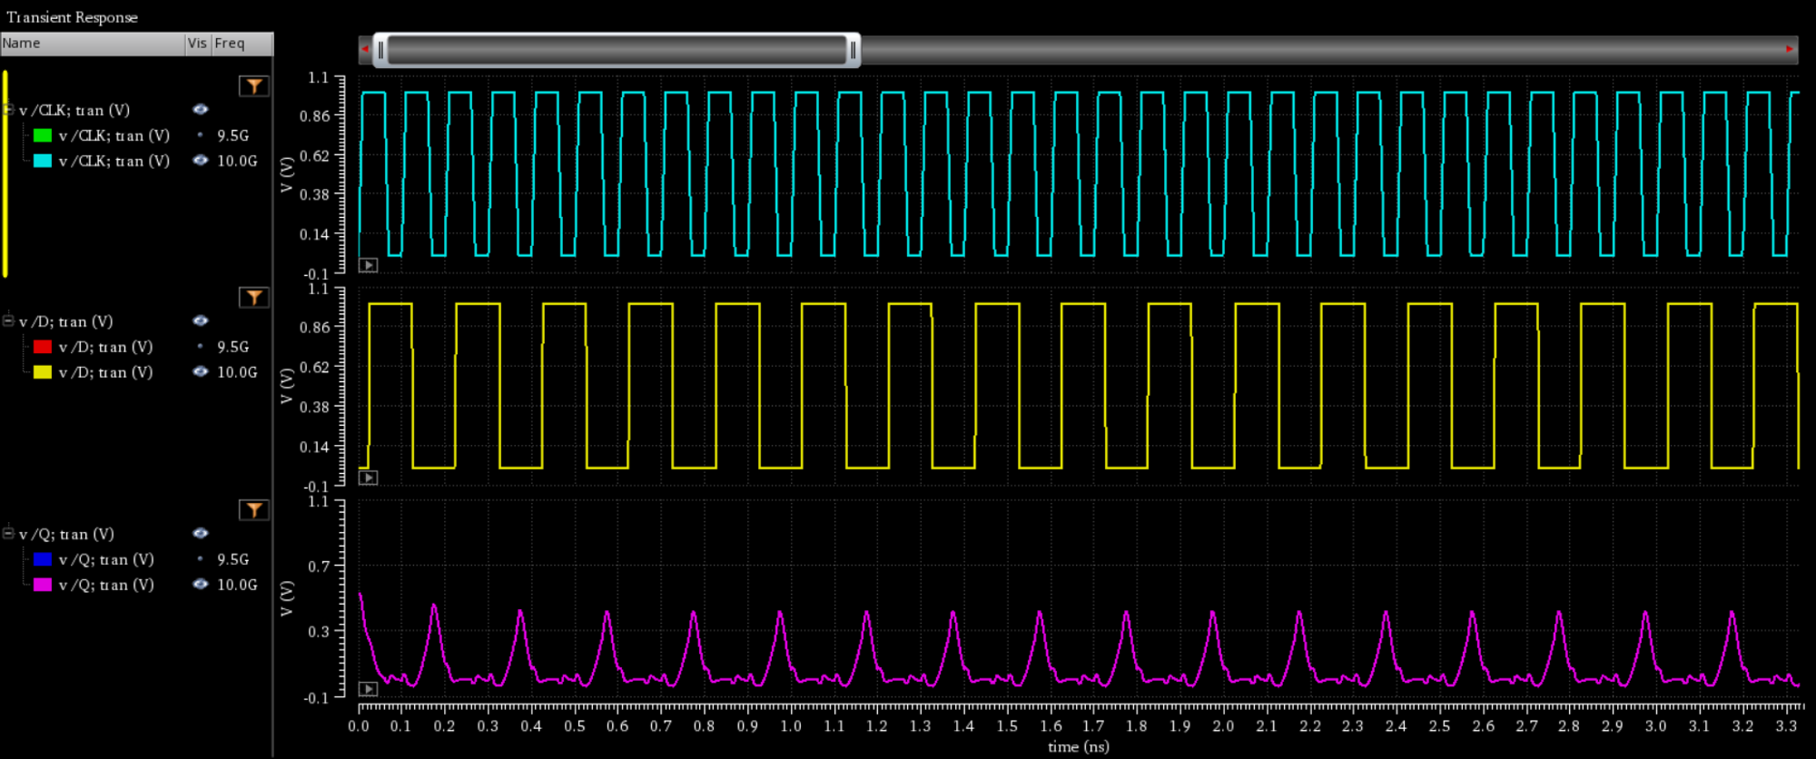
03 : Asynchronous-reset TGFF
Appendix : D F/F vs Asynch.-reset TGFF
Asynchronous-reset TGFF Simulation at 10GHz
Output at 10GHz : Error data occurred

Slide 32
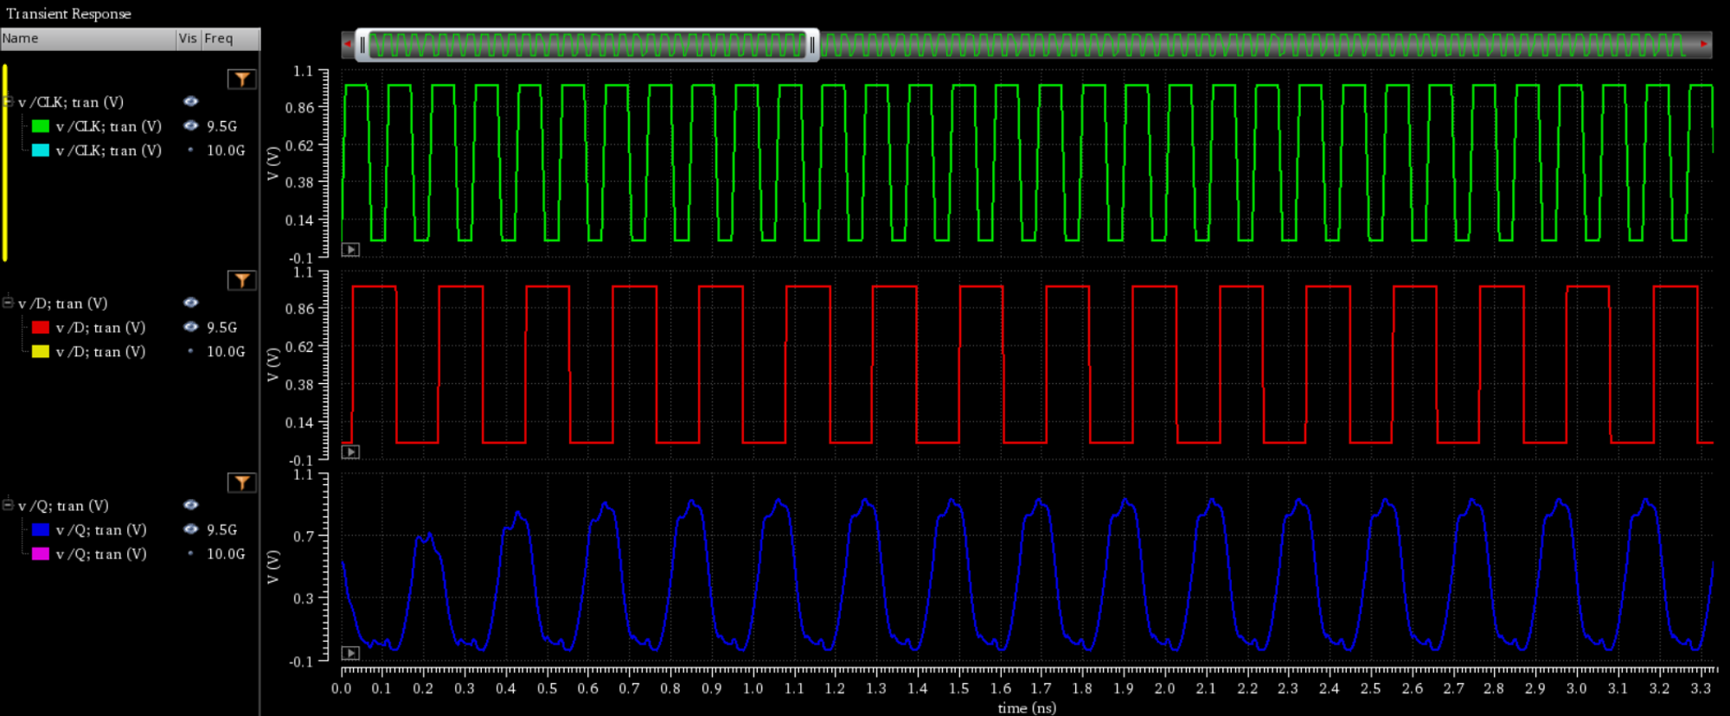
03 : Asynchronous-reset TGFF
Appendix : D F/F vs Asynch.-reset TGFF
Asynchronous-reset TGFF Max-Frequency Simulation at 9.5GHz
Output at 9.5GHz
Max. Frequency = 9.5GHz

Slide 33
Logic Circuit
Operation
Schematic & Symbol
Simulation
Layout (W/ DRC & LVS)
Additional Analysis_1 : Max Frequency
04
Universal Shift Register

Slide 34
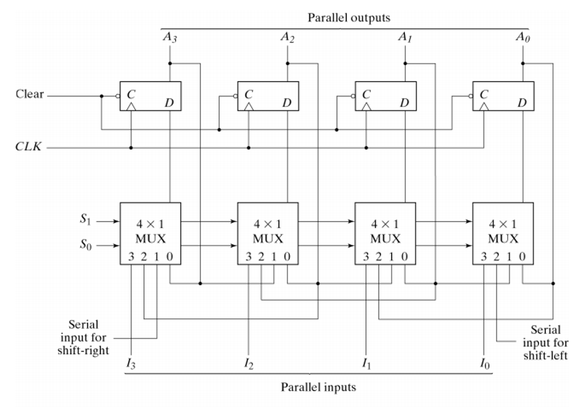
04 : Universal Shift Register
Logic Circuit
<Universal Shift Register>
Universal Shift Register
Universal Shift Register : Logic Curcuit
<Universal Shift Registe Logic circuit>

Slide 35
04 : Universal Shift Register
Operation
S1 | S0 | Operation
0 | 0 | Data hold
0 | 1 | Right Shift
1 | 0 | Left Shift
1 | 1 | Parallel load
Universal Shift Register : Logic Curcuit
<Universal Shift Registe Logic circuit>

Slide 36


04 : Universal Shift Register
Operation
Data hold
$$s_{0}=0, s_{1}=0$$
4x1 MUX Select no.0

Slide 37


04 : Universal Shift Register
Operation
Right shift
$$s_{0}=1, s_{1}=0$$
4x1 MUX Select no.1

Slide 38


04 : Universal Shift Register
Operation
Left shift
$$s_{0}=0, s_{1}=1$$
4x1 MUX Select no.2

Slide 39


04 : Universal Shift Register
Operation
Parallel load
$$s_{0}=1, s_{1}=1$$
4x1 MUX Select no.3

Slide 40

04 : Universal Shift Register
Schematic & Symbol
Schematic
Out_0
Out_1
Out_2
Out_3
Asynchronous-reset
TGFF
v
4x1 MUX Switch
2x1 MUX Switch
Right Shift
Left Shift
Input 0
Input 1
Input 2
Input 3

Slide 41

04 : Universal Shift Register
Schematic & Symbol
Symbol

Slide 42


04 : Universal Shift Register
Simulation
CLK
LS
RS
Input_0
Input_1
Input_2
Input_3
S1
S1 = 0 S0 = 1
Right Shift (RS)
S1 = 0 S0 = 0
Hold
S0
RST
RST
Out_0
0
Out_1
0
Out_2
0
Out_3
0

Slide 43


04 : Universal Shift Register
Simulation
CLK
LS
RS
Input_0
0
Input_1
0
Input_2
1
Input_3
0
S1
S1 = 1 S0 = 0
Left Shift (LS)
S1 = 1 S0 = 1
Parallel load
S0
RST
Out_0
0
Out_1
0
RST
Out_2
1
Out_3
0
Out_0
0

Slide 44

04 : Universal Shift Register
Layout (W/ DRC & LVS)
Layout
Length | 50.925
Width | 11.72
Scale : [um]

Slide 45




04 : Universal Shift Register
Layout (W/ DRC & LVS)
DRC
LVS

Slide 46


04 : Universal Shift Register
Additional Analysis_1 : Max. Frequency
Standard of Max. Frequency
Logic Level Standard
Output Logic High Level : 600mV ↑ (60% VDD)
Output Logic Low Level : 100mV ↓ (10% VDD)
Refer to TI SN54AS194, SN74AS194
(4-bit Universal Shift Register)
$$V_{OH} ≥3.5$$
$$V_{LH}≤0.5$$
$V_{CC}=5.5$V
60% $V_{CC}$ $≅3.5$V
10% $V_{CC}$ $≅0.5$V

Slide 47

04 : Universal Shift Register
Additional Analysis_1 : Max. Frequency
Simulation at 4GHz (Right shift operation)
As expected, the data should change to ‘0’ at the clock’s positive edge.
But, Data stays ‘1’
Out_0
Out_1
Out_2
Out_3

Slide 48

04 : Universal Shift Register
Additional Analysis_1 : Max. Frequency
Simulation at 2.7GHz
CLK = 2.7GHz → Normal operation (Right shift operation)
∴ Max Freq. = 2.7GHz

Slide 49


04 : Universal Shift Register
Additional Analysis_2 : Setup time / Hold time
Setup time / Hold time
Setup time
If D changes extremely close to CLK
→ Cannot see D changing at the positive edge of CLK
→ Q may malfunction
∴ Setup time means that D must be set up
at some point before CLK comes.
Hold time
If the value of D changes immediately after the CLK edge, the changed value of D can be recognized.
∴ Hold time is how much D value must be
maintained after CLK ends
Setup time
Hold time

Slide 50

04 : Universal Shift Register
Additional Analysis_2 : Set time
 | S1 | S0 | CLK | IN
source type | Pulse | Pulse | Pulse | Pulse
Voltage range | 1 ~ 0V | 0 ~ 1V | 0 ~ 1V | 0 ~ 1V
Period | 8ns | 8ns | 1/(Freq) | 2/(Freq)
Delay time | 0s | 0s | 0s | 388.39p (delay)
Rise time | 1ps | 1ps | 1/(Freq*10) | 1ps
Fall time | 1ps | 1ps | 1/(Freq*10) | 1ps
Pulse width | 4ns | 4ns | 1/(Freq*2) | 2/(Freq*2)
Simulation time | 8n
Increase the delay variable within a certain range
to check if the output is normal.

Slide 51


04 : Universal Shift Register
Additional Analysis_2 : Set time
Setup time = 70p
CLK
Input data
Out_0
CLK
Input data
Since Input data is 0 at CLK Rising edge,
Out_0 must change to 0 for normal operation.
But, data does not change.
⇒ Malfunction
Out_0

Slide 52

04 : Universal Shift Register
Additional Analysis_2 : Set time
Setup time = 100p
Shift operation is complete
But, Output is over logic level
Low logic level standard = 100mV
High logic level standard = 600mV
107.94mV

Slide 53


04 : Universal Shift Register
Additional Analysis_2 : Set time
Setup time = 113p
Shift operation is complete
CLK
Input data
Out_0

Slide 54
05
Review
Problem
Review

Slide 55


05 : Review
Review
Hold time
CLK
CLK
Input data
Input data
Out_0
Out_0
Even though the hold time was changed from 120p to 0p, the hold time was not measured.
But, That’s no problem. Because Negative hold time exists

Slide 56



05 : Review
Review
Hold time
Refer to 74HC590 (8-bit binary counter with output register ; 3 state)
It has set up time but no hold time
Refer to 74HC299 (8-bit Universal shift register ; 3 state)
→ It has negative hold time

Slide 57

05 : Review
Review
Size
To reduce the layout size, use MUX SWITCH instead of MUX LOGIC to reduce the size.
4x1 MUX LOGIC area : 100.862 $um^{2}$
4x1 MUX SWITCH area : 52.421 $um^{2}$
Using 4 of 4x1 MUX SWITCH → Save 48.14% of Total area
Logic curcuits
I learned why the universal shift register is needed and what function it performs.
and, I could Think about what I need to consider when designing digital circuits
Cross-coupled
Setup time, Hold time
Latch & Filp-flop operation

